Slide 1
ForceMoCap (FMC)
Evaluation Protocol

Slide 2
Study 1: Single Quasi-static 6-DOF joint

Slide 3
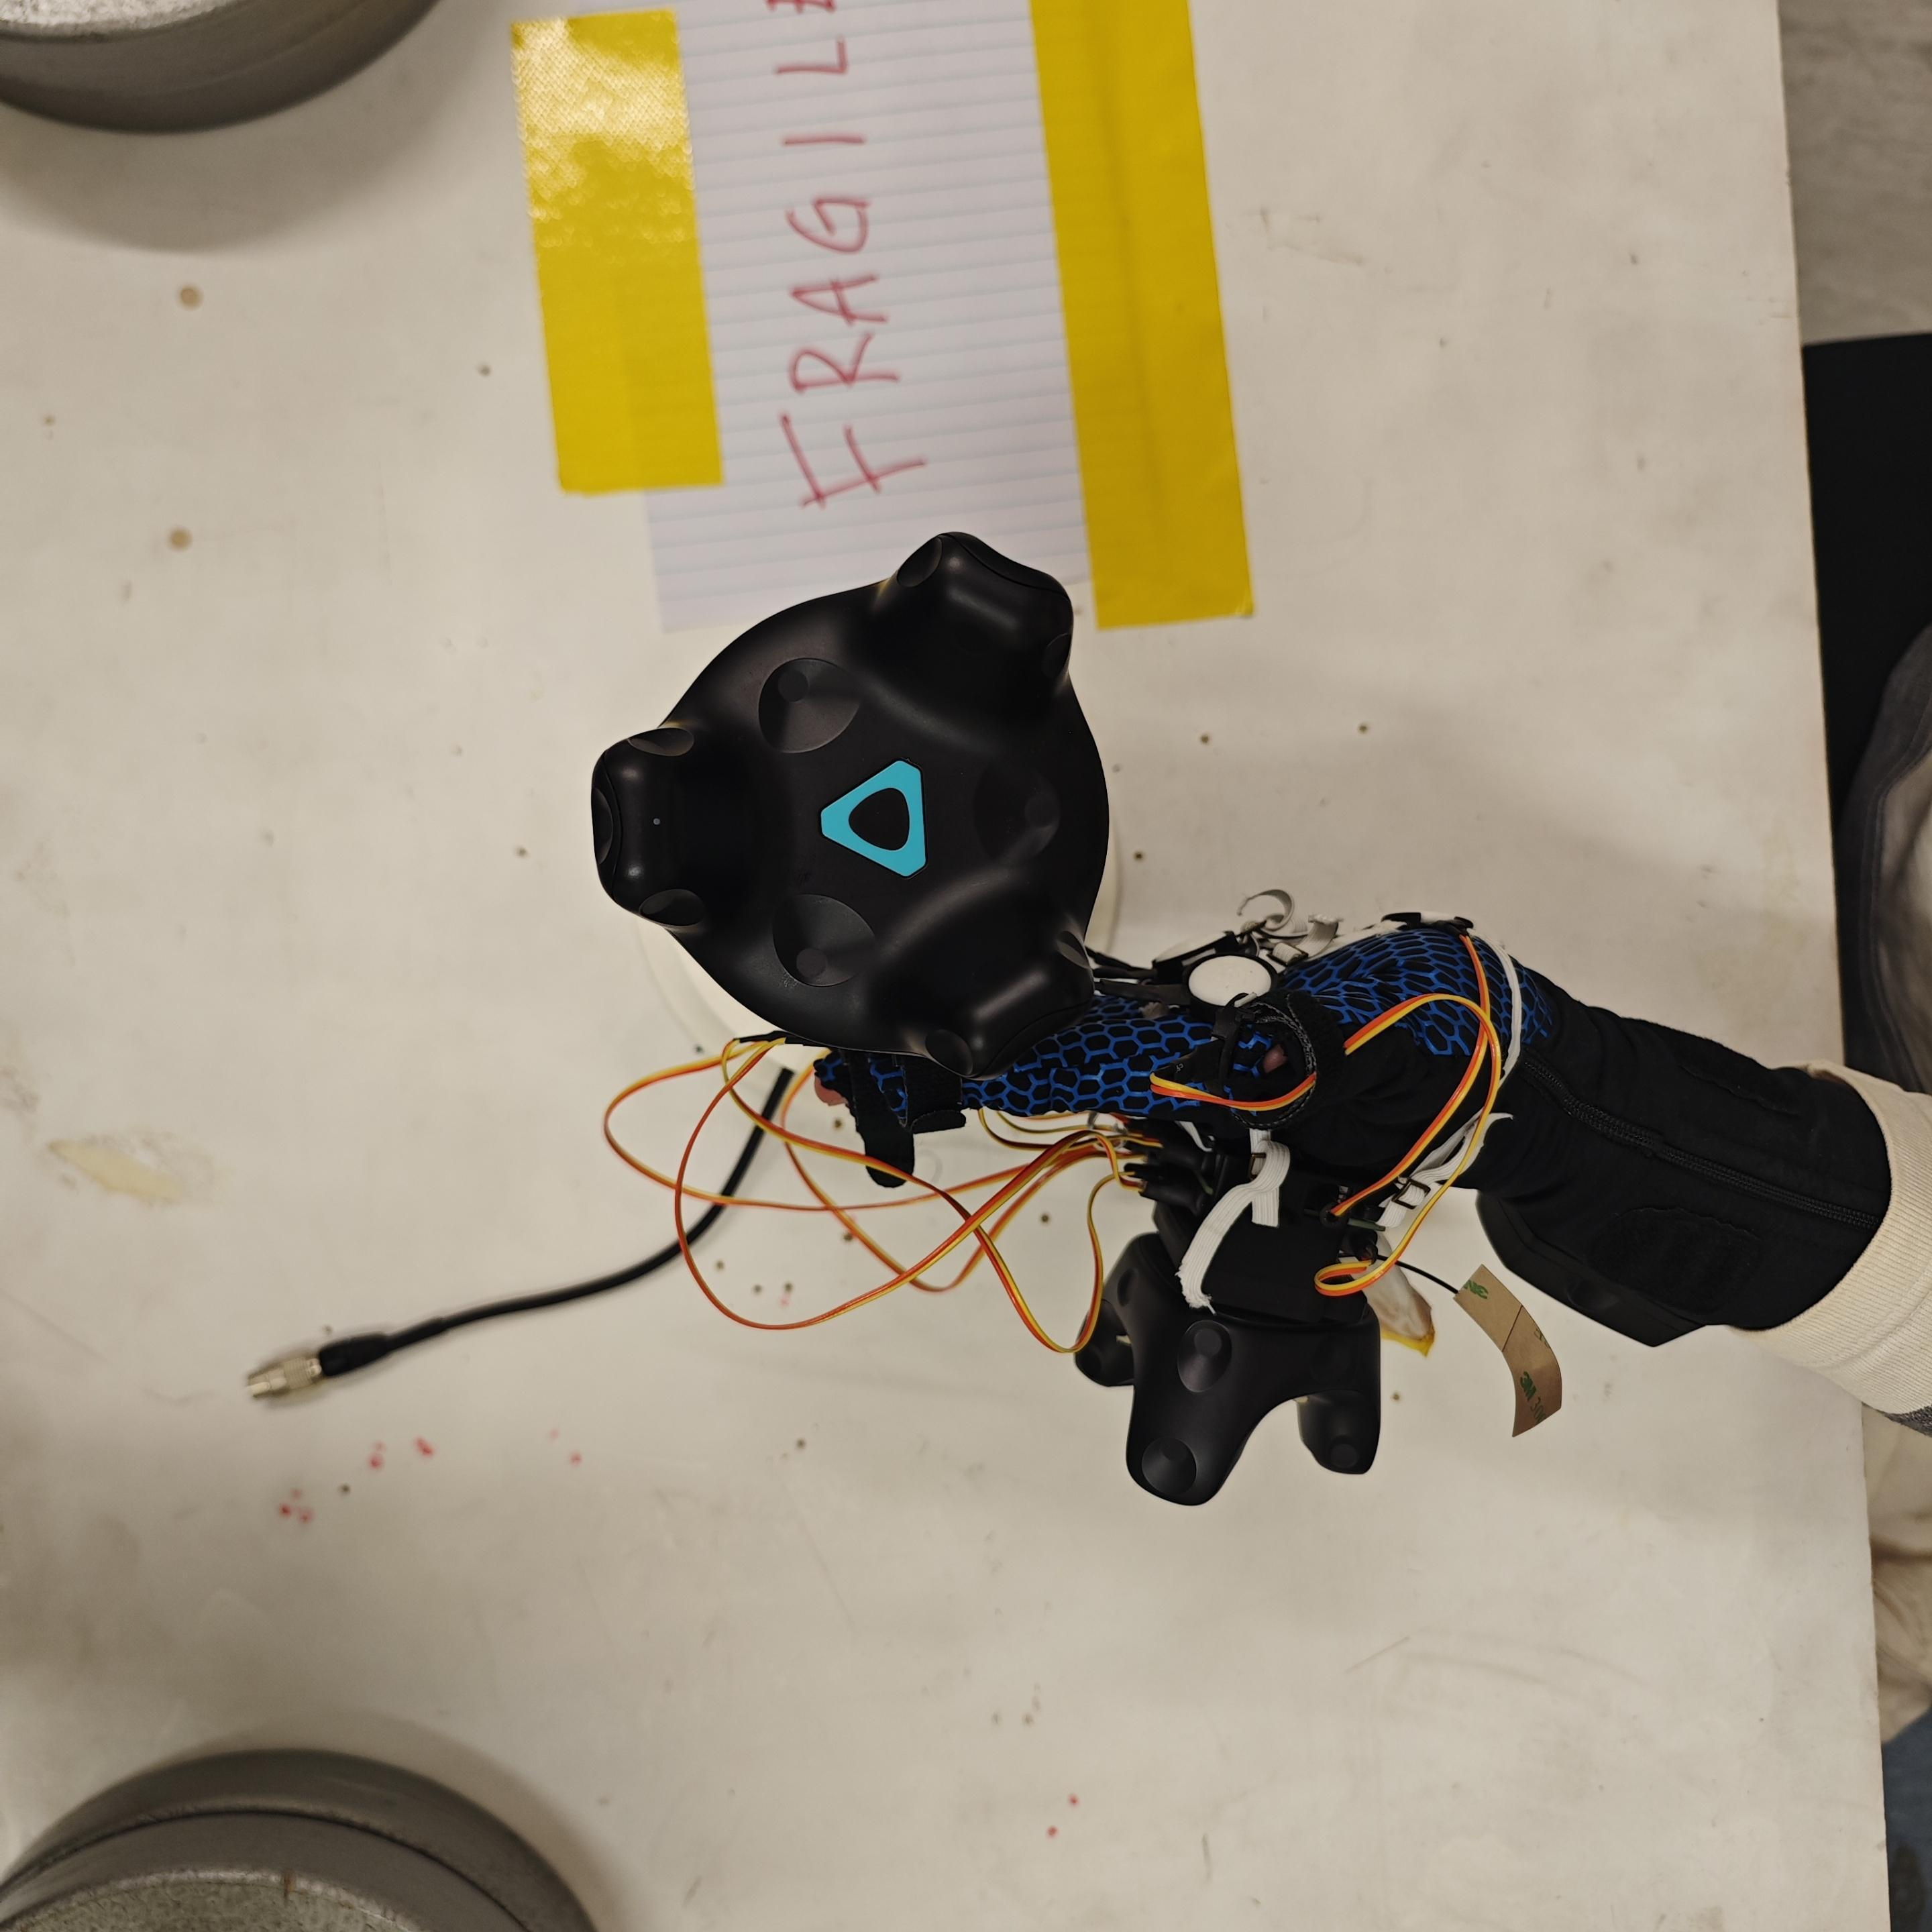
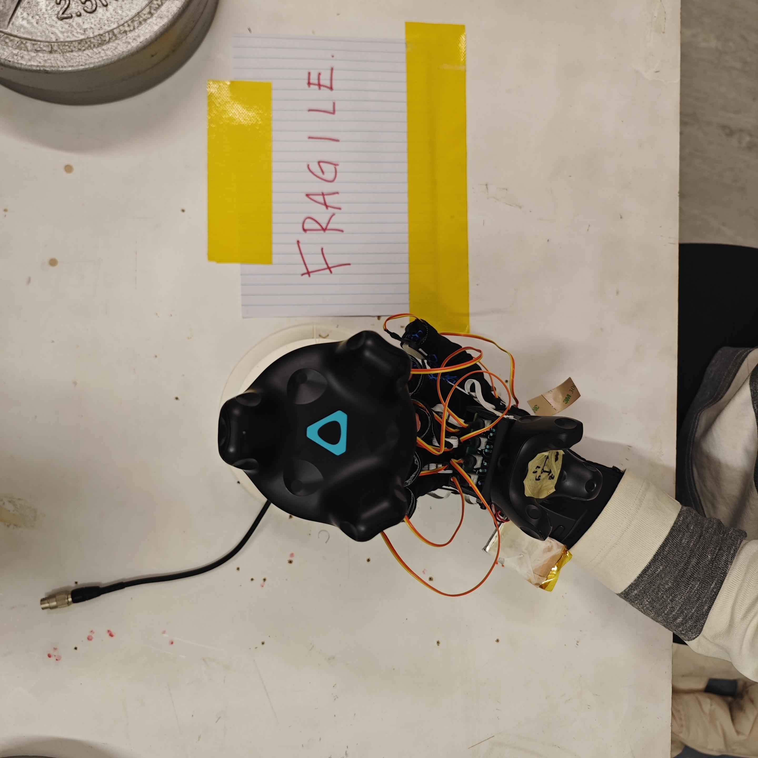
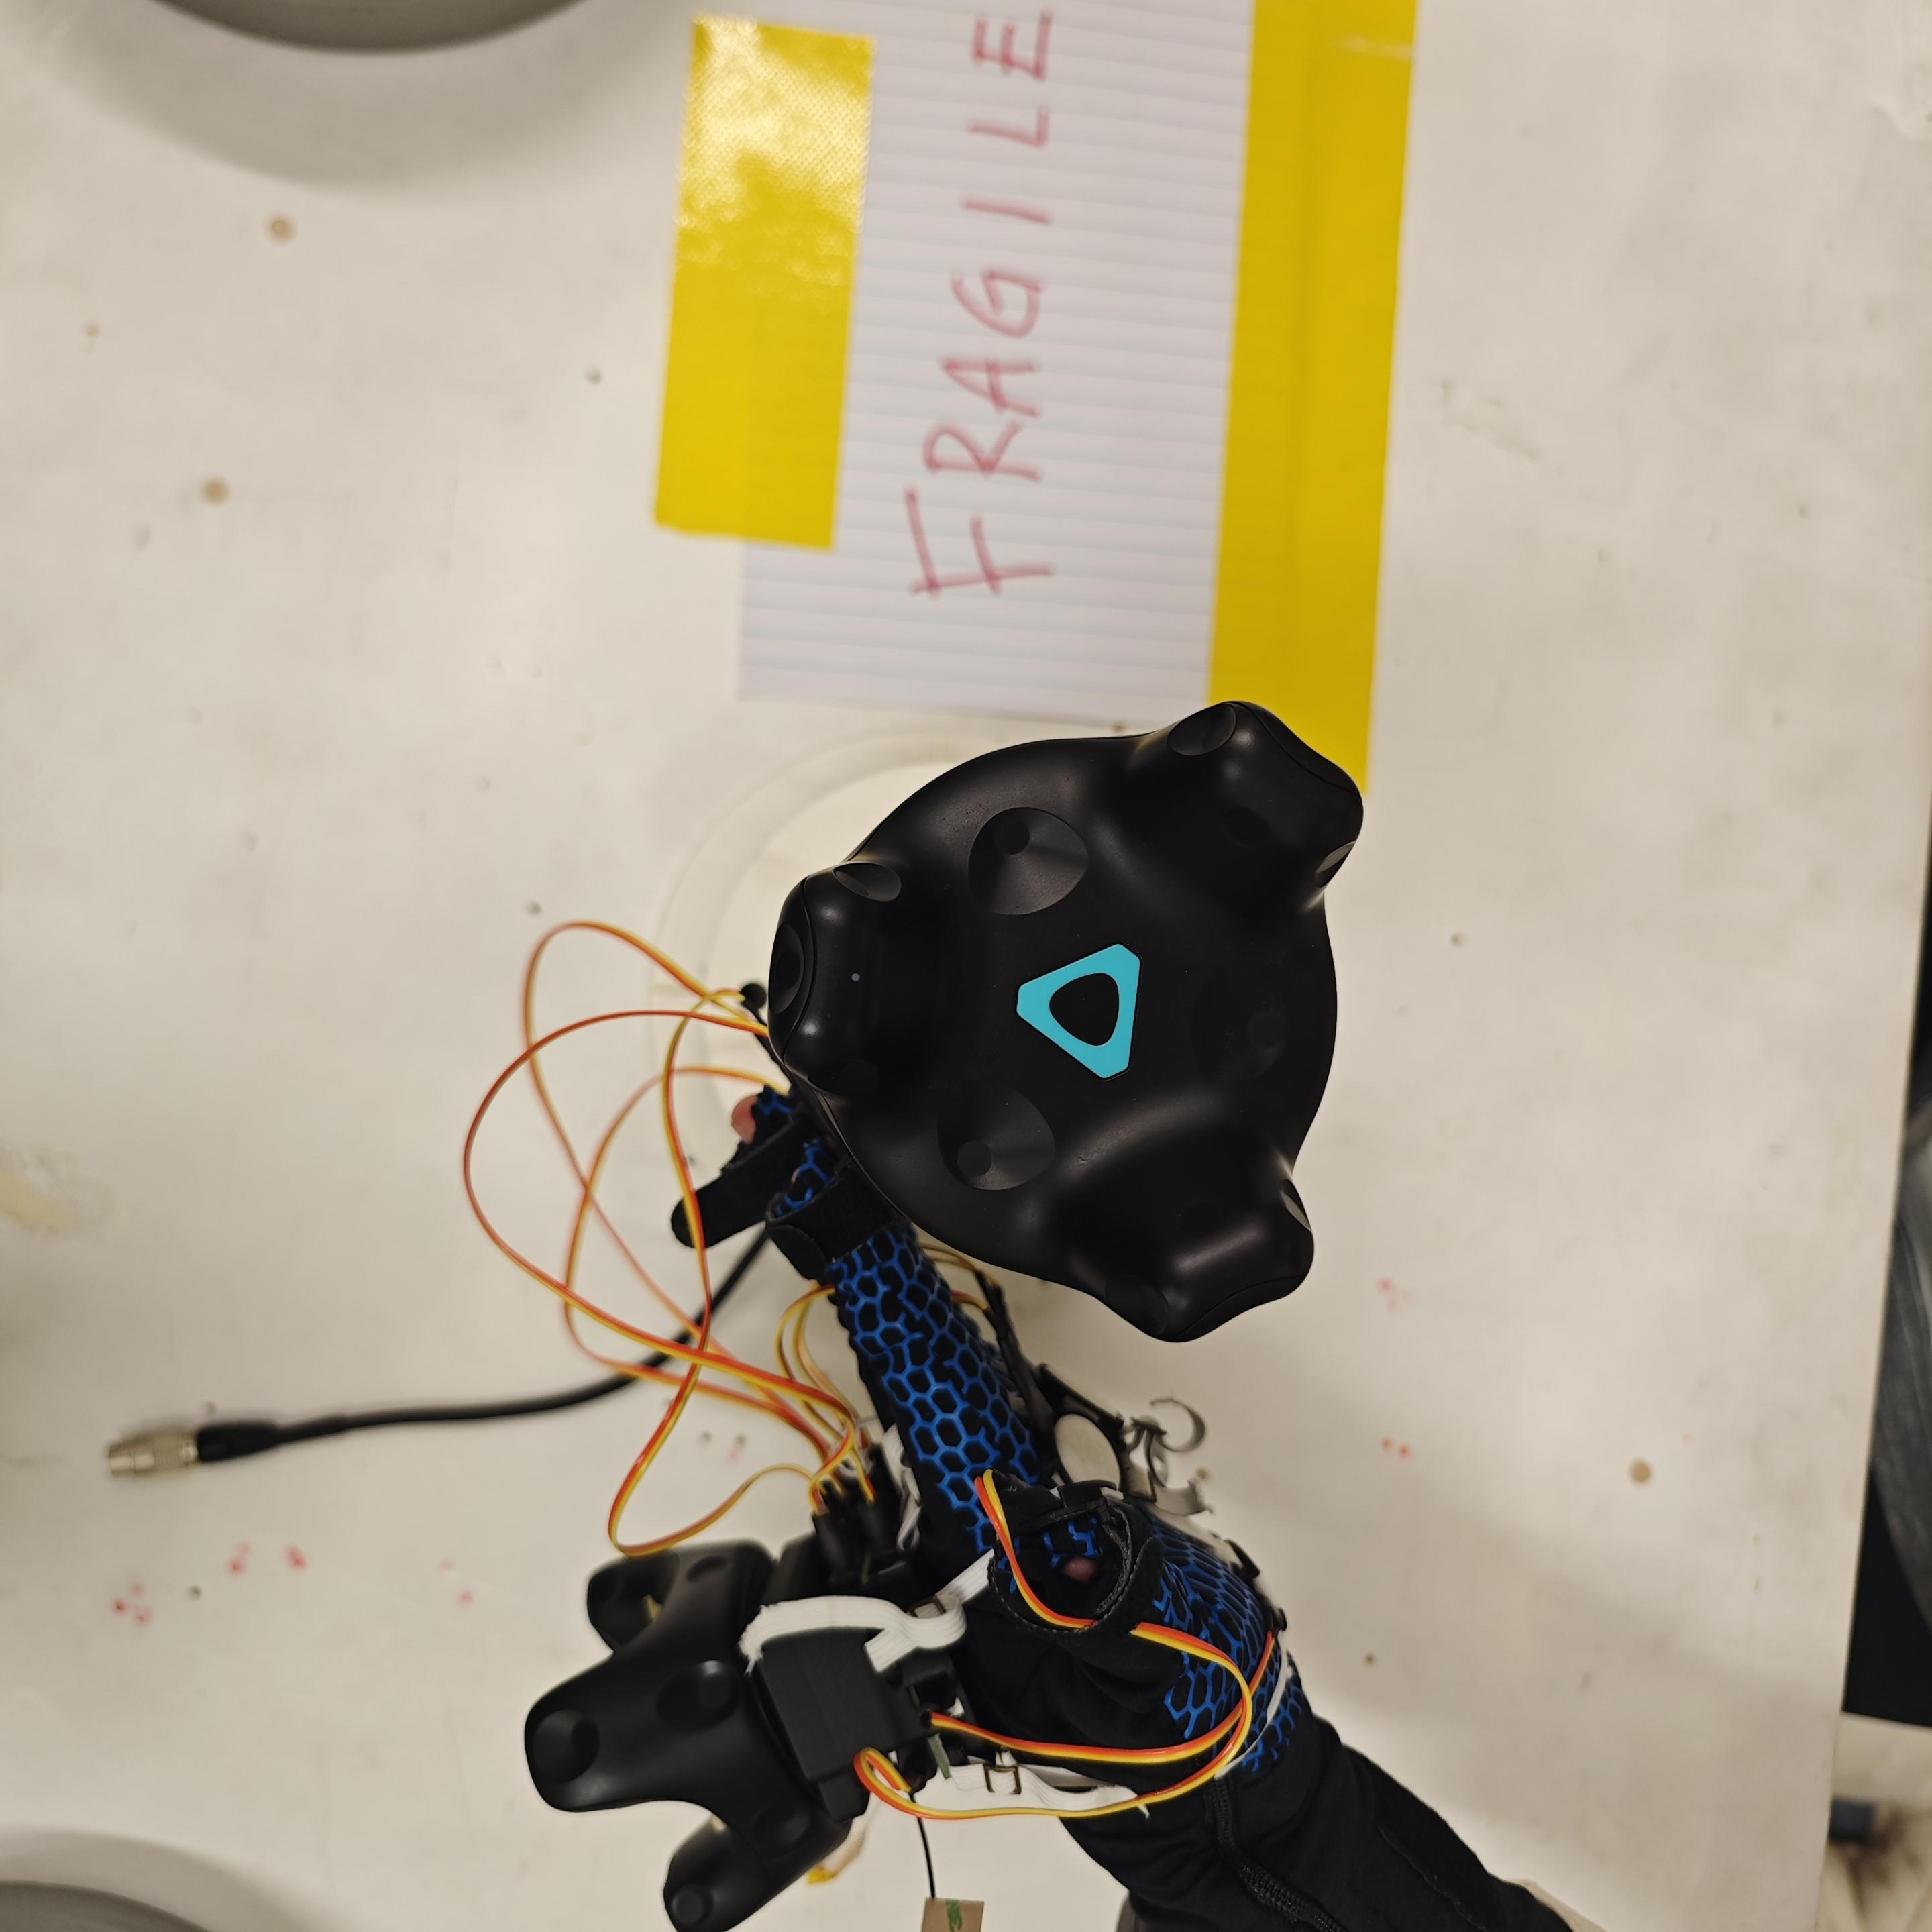
Study 1a: Normal Force Dynamics
Y
Direction of force
Type 1: Fingers Force
X
Y
Y
Y
X
X
X
X-force
Y-force
XY-force

Slide 4
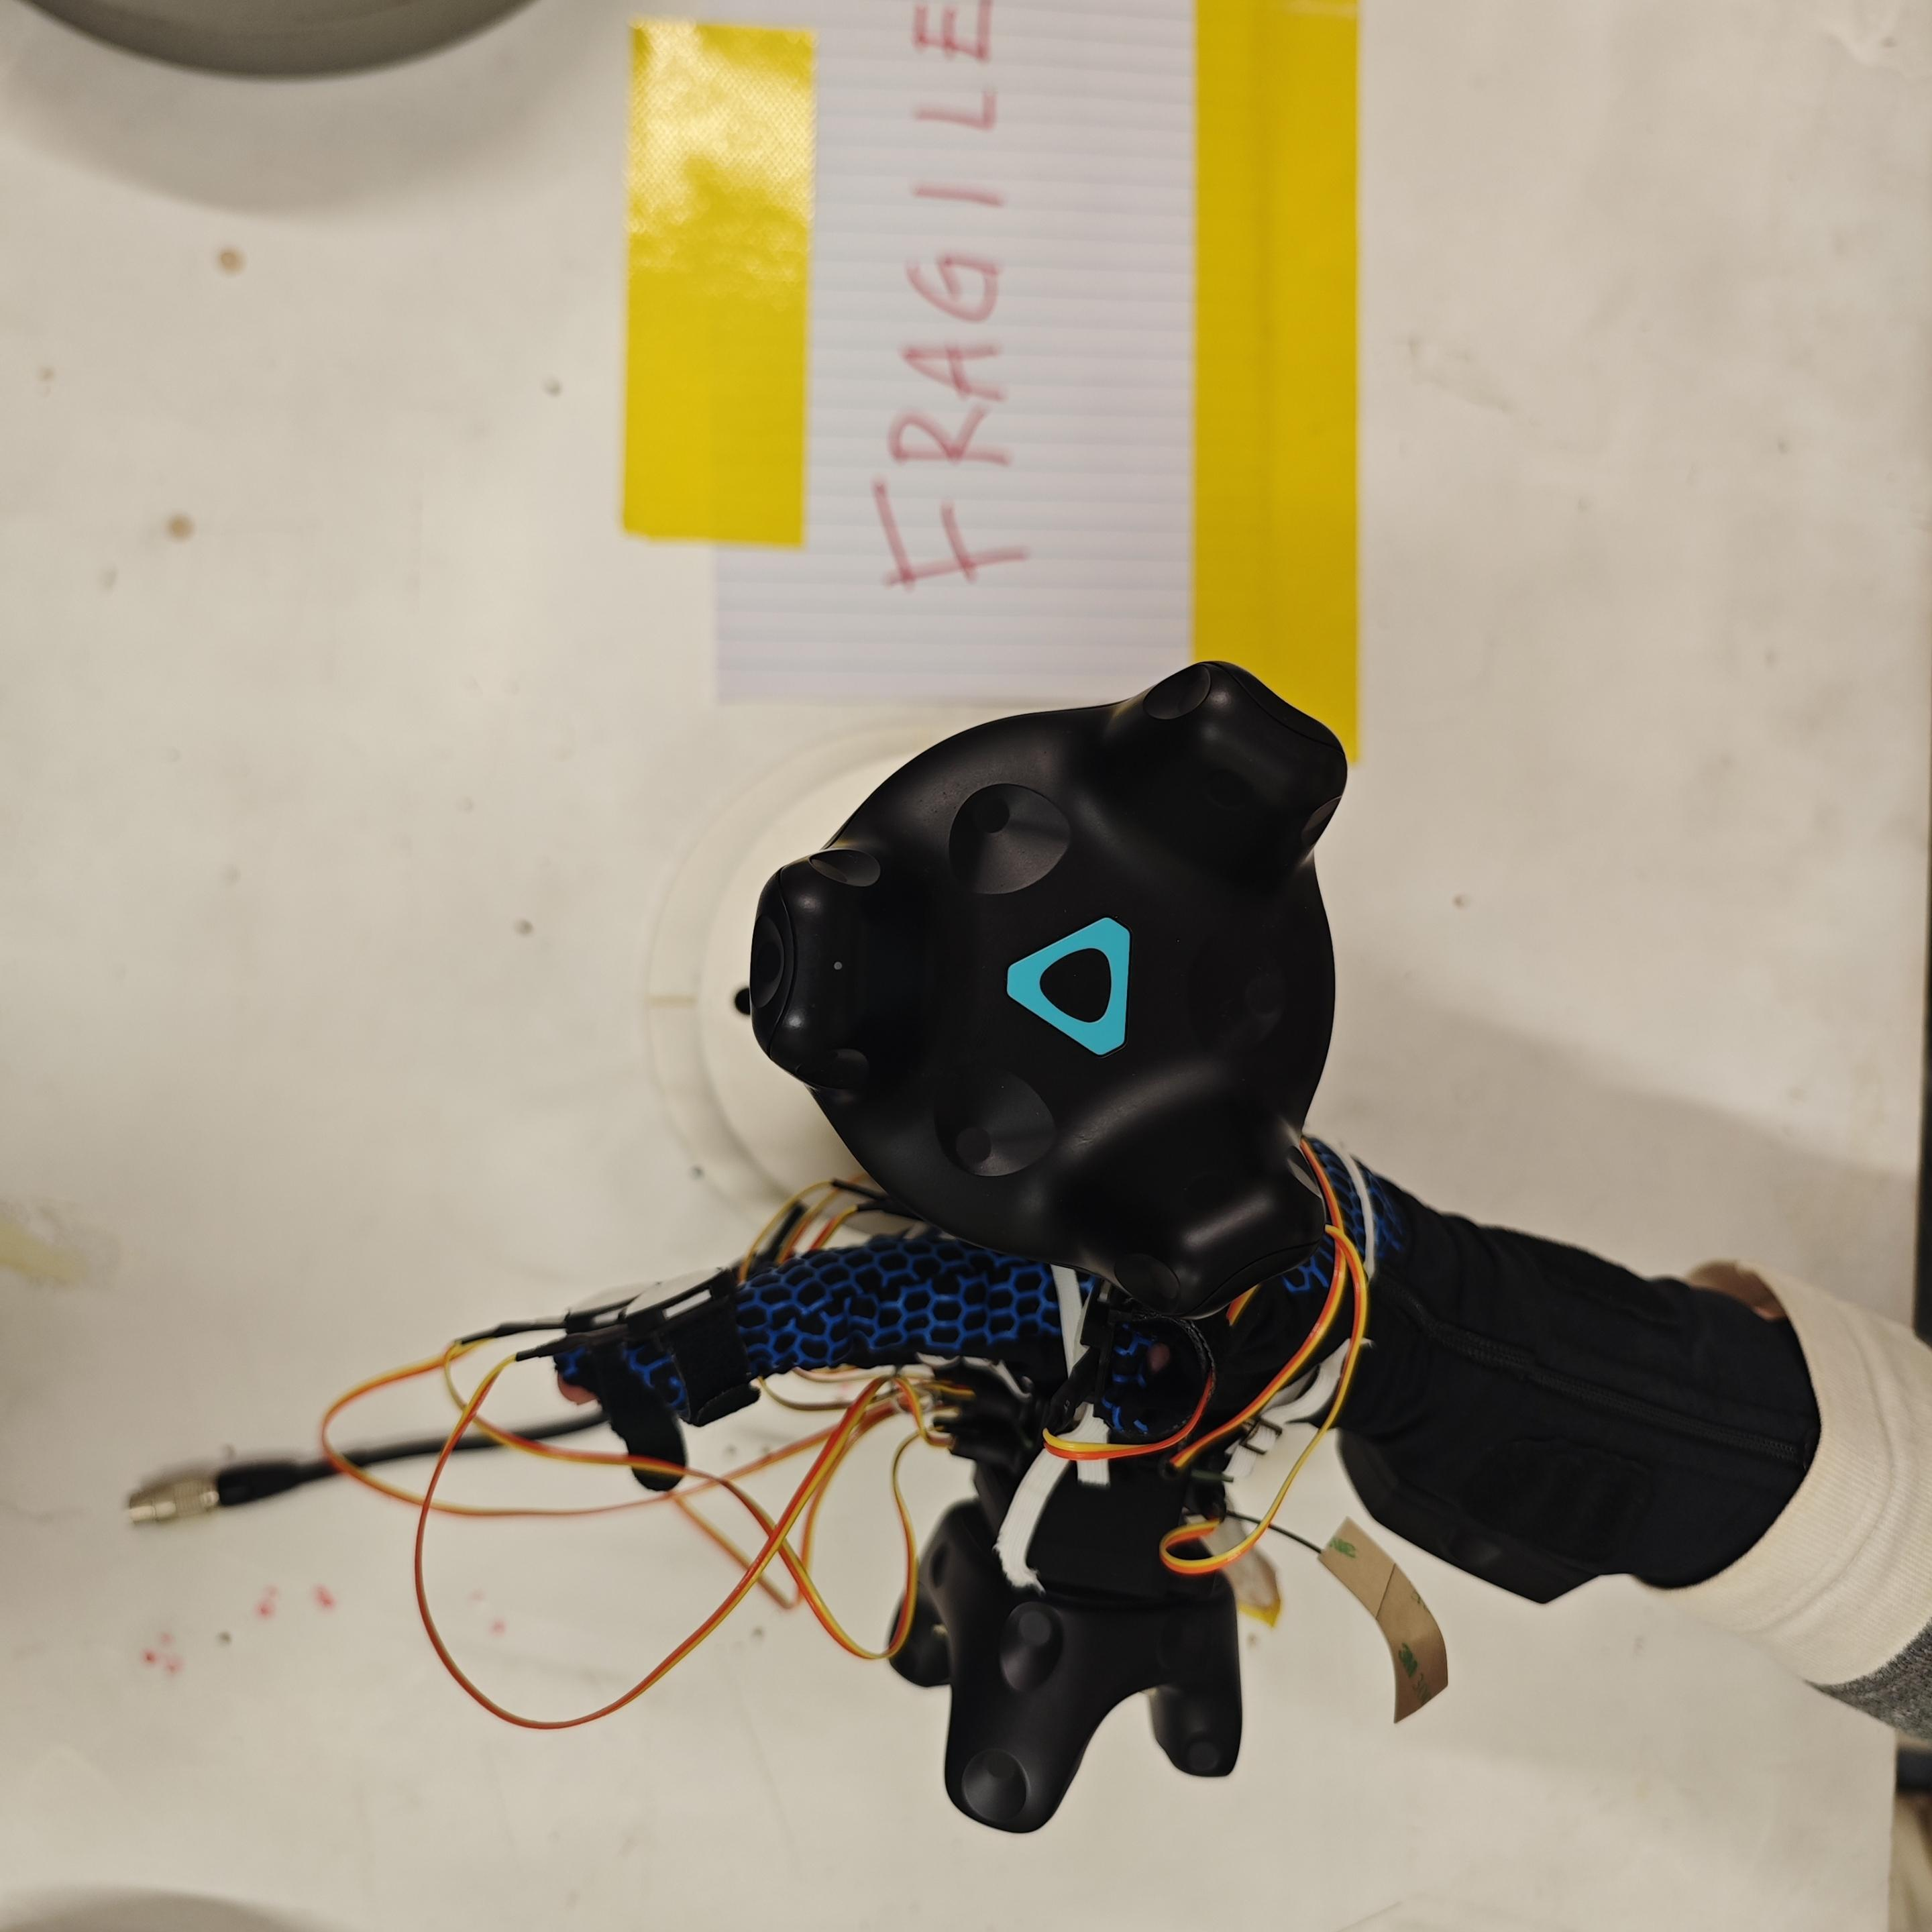
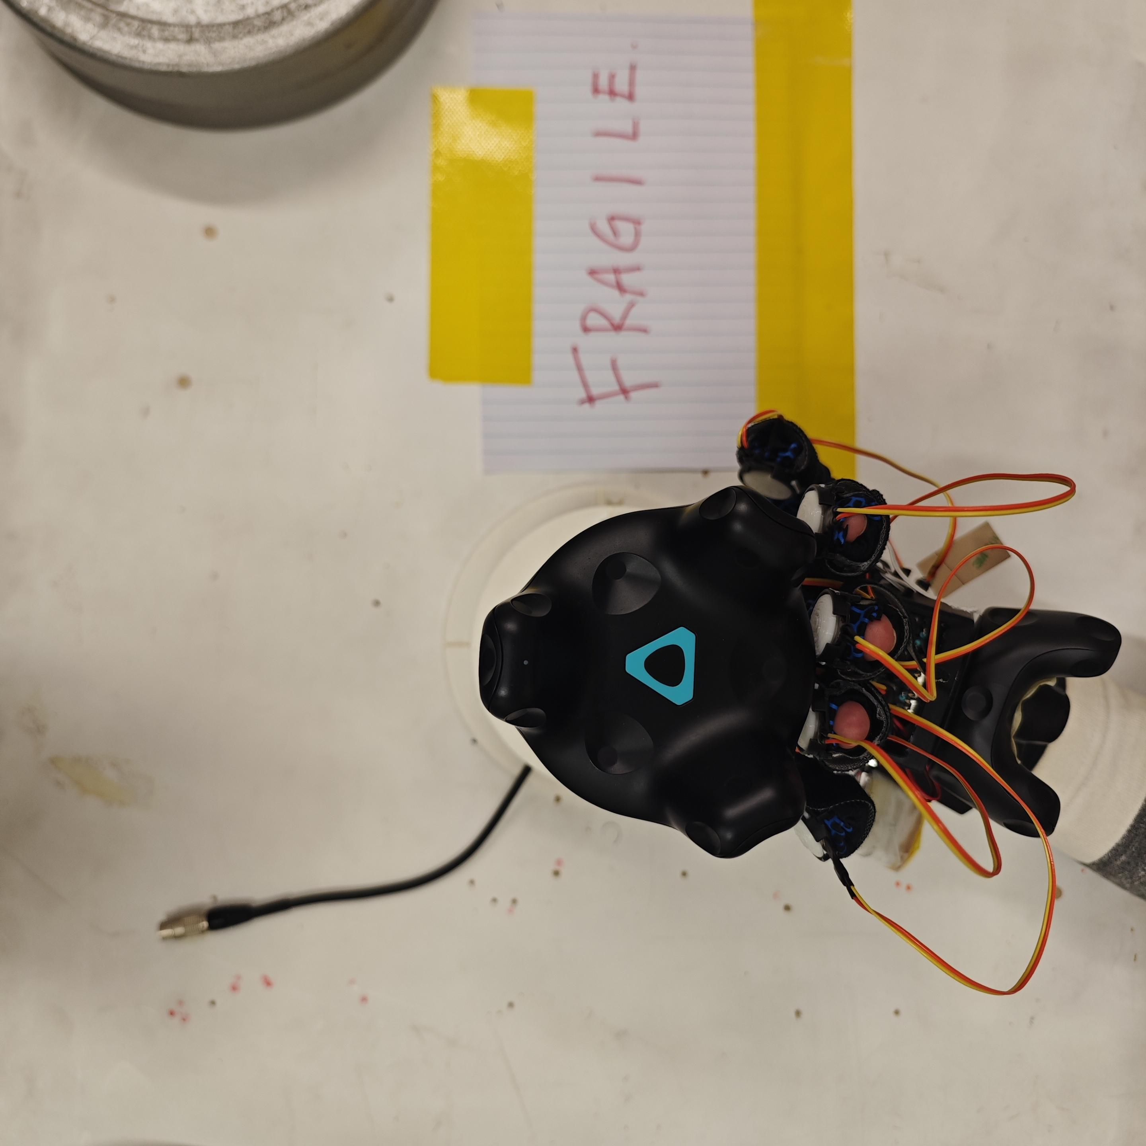
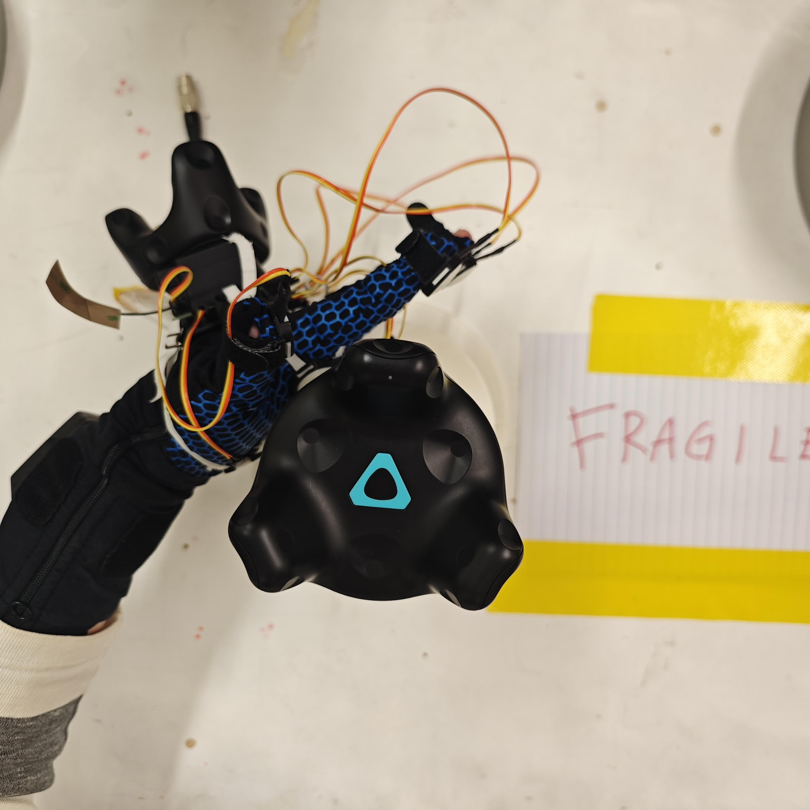
Study 1a: Normal Force Dynamics
Y
Direction of force
Type 2: Palm Force
X
Y
Y
Y
X
X
X
X-force
Y-force
XY-force

Slide 5
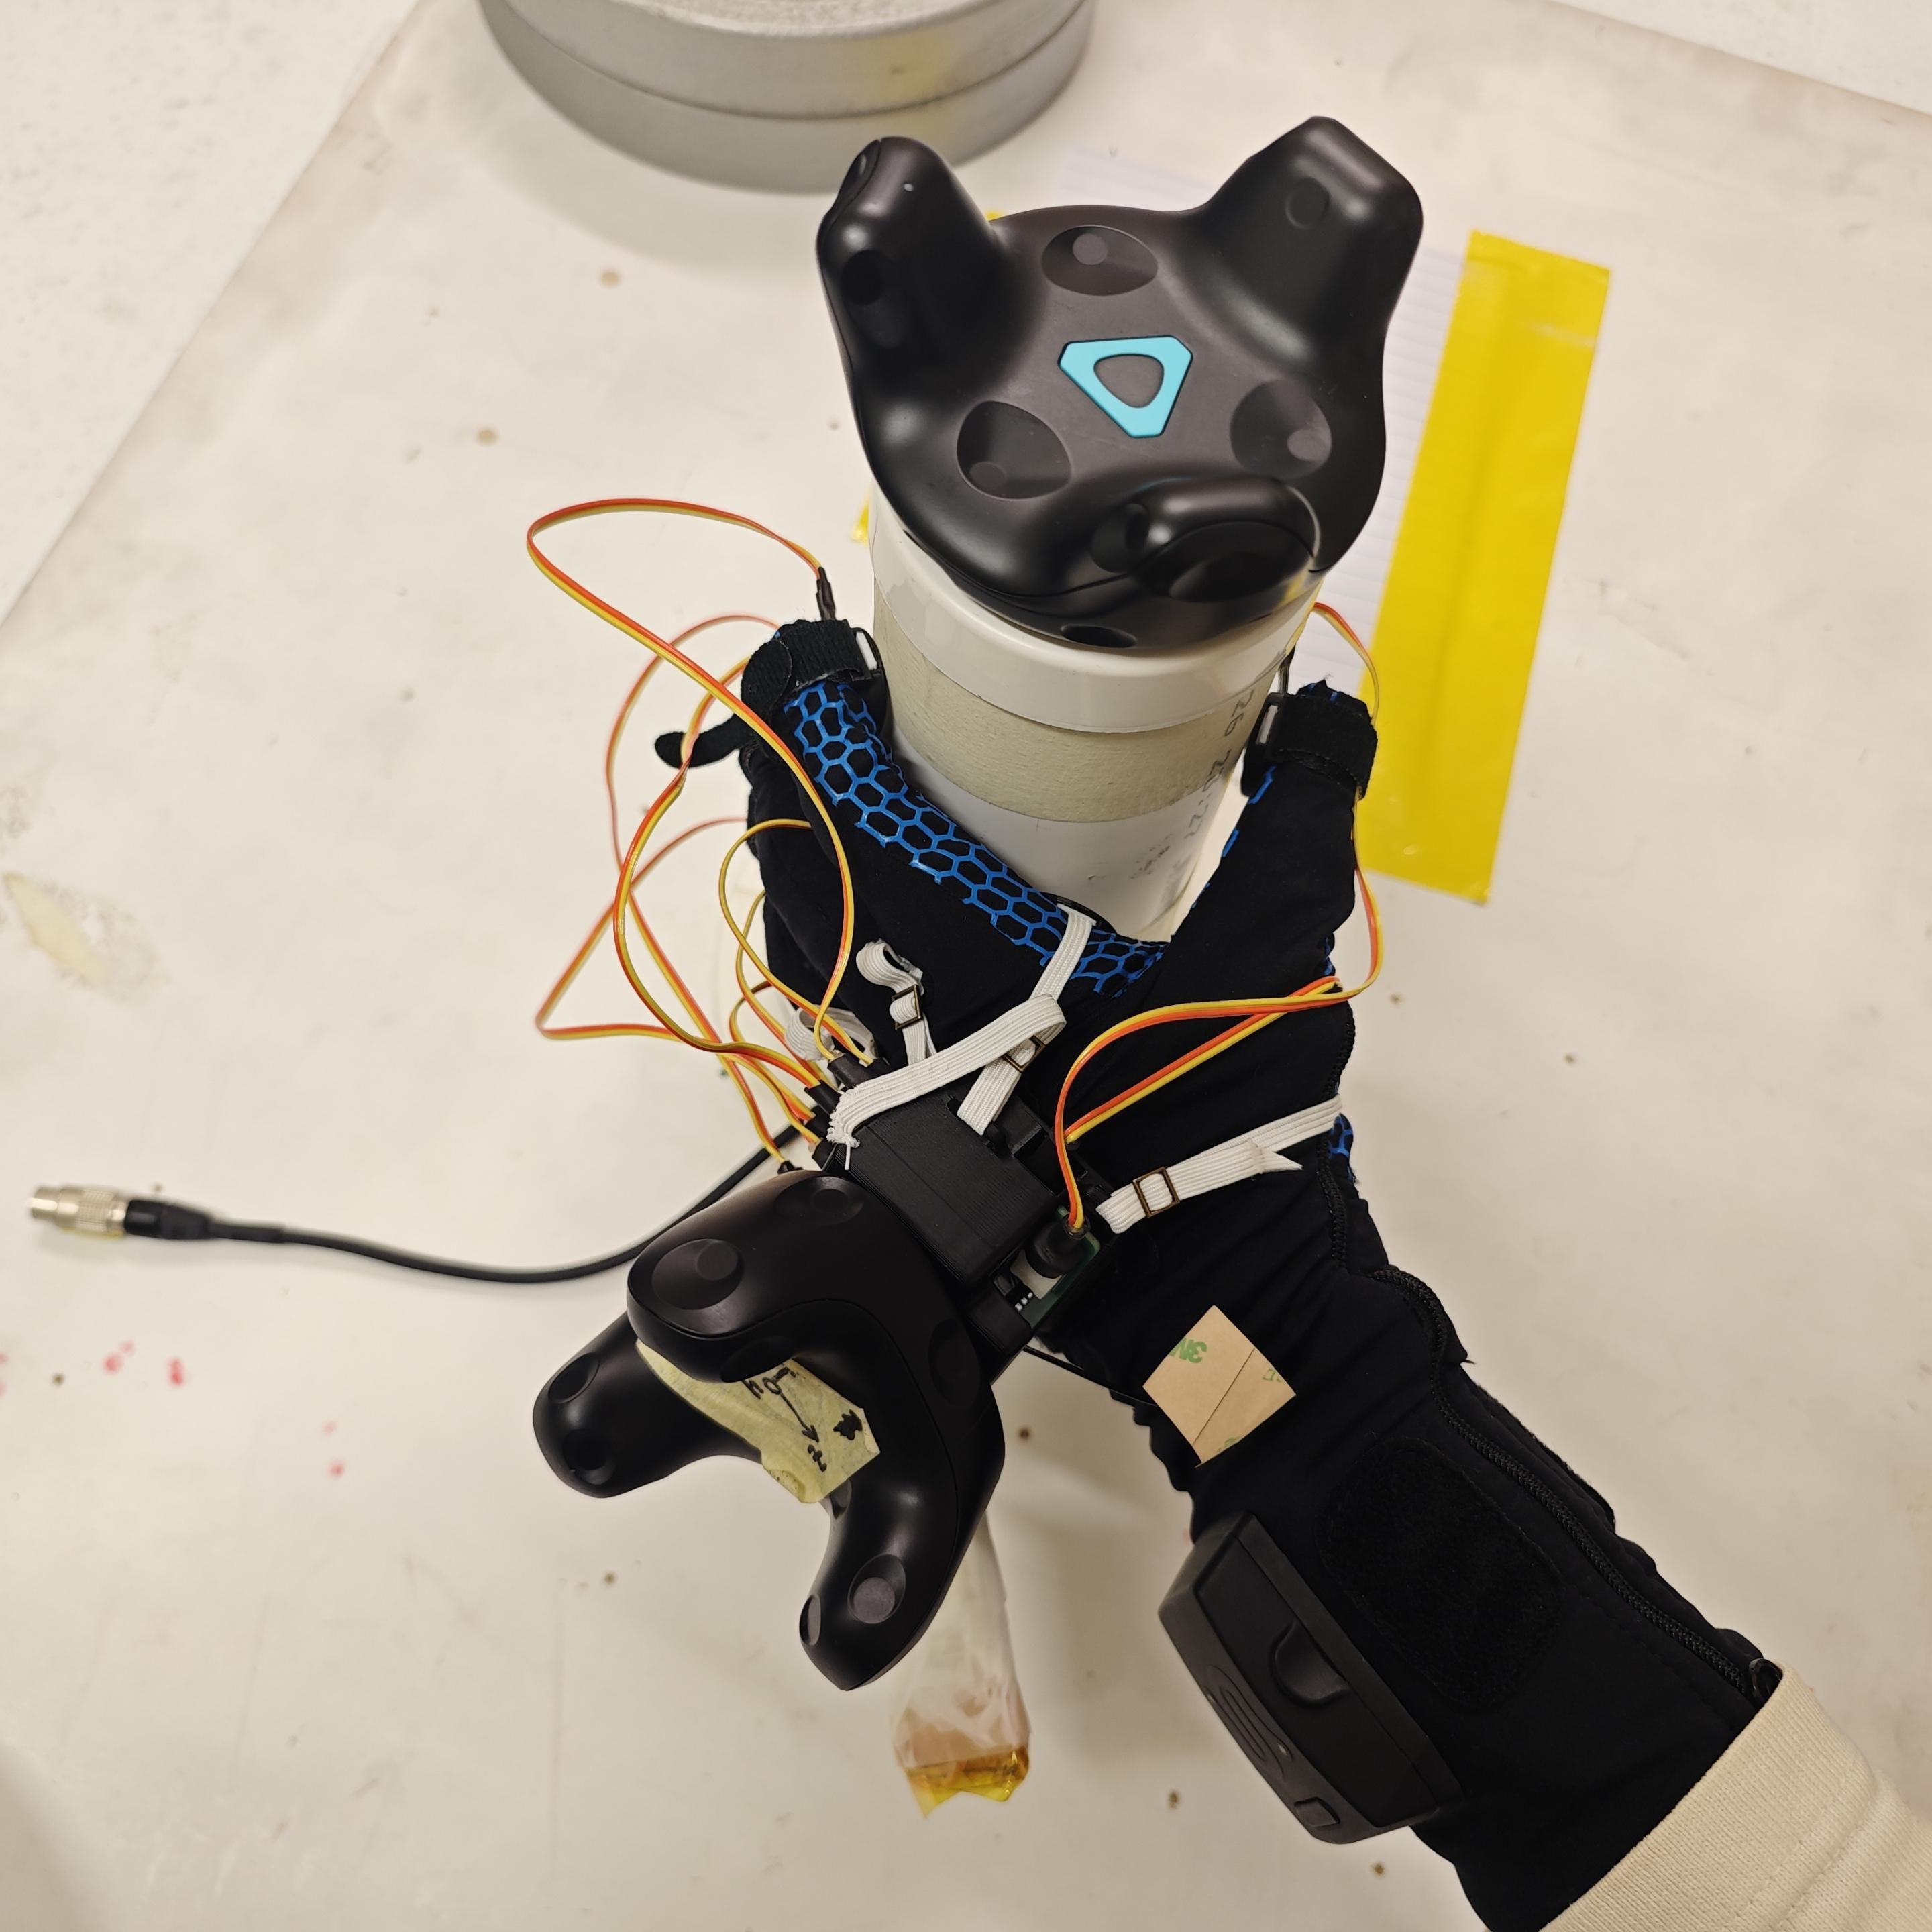
Study 1b: Grasp Dynamics
Type 1: Finger Grasp
Massage
Z axis lift / push

Slide 6
Study 1b: Grasp Dynamics
Type 1: Finger Grasp
X-axis twist
Y-axis twist
Z-axis twist

Slide 7
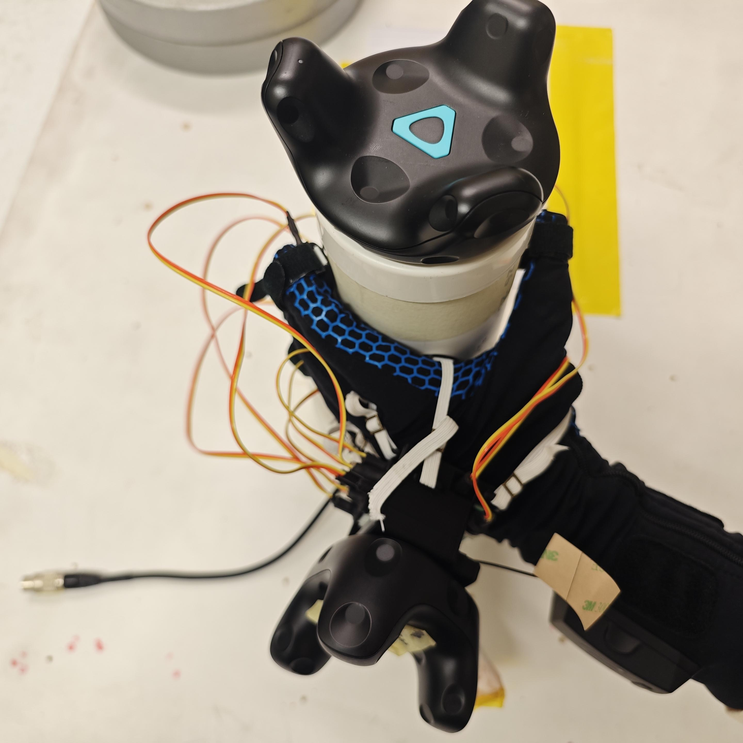
Study 1b: Grasp Dynamics
Type 2: Power Grasp
Massage
Z axis lift / push

Slide 8
Study 1b: Grasp Dynamics
Type 2: Power Grasp
X-axis twist
Y-axis twist
Z-axis twist

